Slide 1


Proposal by <TEAM NAME>
Note: This is a reference Slide. Add as many details as you want. (New PPT should be created)

Slide 2

MEET THE TEAM
Your Name
Your Name
Your Name
Your Name
Your Name
About You
About You
About You
About You
About You

Slide 3

Problem Statement
Manual medical image analysis causes diagnostic delays
Problem Statement Expansion
Manual medical image analysis creates significant diagnostic bottlenecks, leading to delayed treatments and increased clinician burnout. By the start of 2026, healthcare providers are increasingly adopting AI to automate anomaly detection, ensuring faster, more accurate results that improve patient survival rates and efficiency
How it manifests for the user or client
SAMPLE for reference, please replace with your project details
Manual medical image analysis creates significant diagnostic bottlenecks, leading to delayed treatments and increased clinician burnout. By the start of 2026, healthcare providers are increasingly adopting AI to automate anomaly detection, ensuring faster, more accurate results that improve patient survival rates and efficiency
PROBLEM STATEMENT
How it impacts the user or client
In 2026, diagnostic delays cause irreversible health decline and massive financial loss for patients. For clinicians, the resulting workload triggers 80%+ burnout rates and fatigue-driven errors, compromising safety and forcing healthcare systems into a reactive, high-cost cycle of crisis management.
Note: This is just a sample for your understanding. Change it as per your details. Don’t change the header.

Slide 4
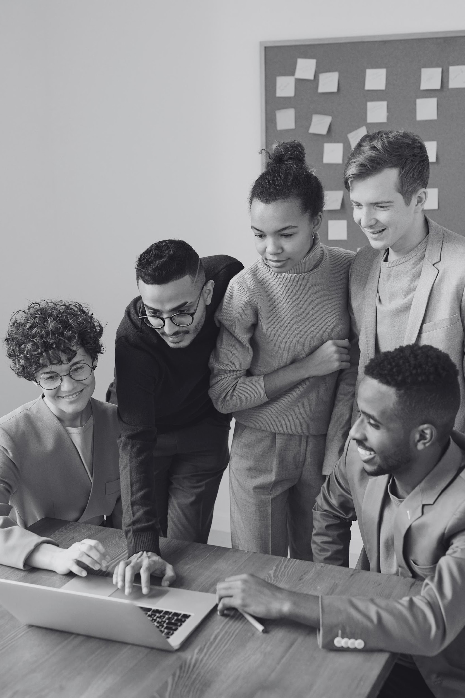



Project Details
Project Name (Try to keep it under 5 words)
Describe your project (Try to keep under 100 words)
Demographic it Impacts

Slide 5
User Persona Mindset
Build for “real humans, not hypothetical users”
Start with people who face “real friction in everyday life”
Think beyond comfort and convenience — focus on “need and necessity”
Assume “constraints”, not perfect conditions
Design for “simplicity, empathy, and dignity”
Aim for solutions that “actually change someone’s day-to-day reality”*

Slide 6

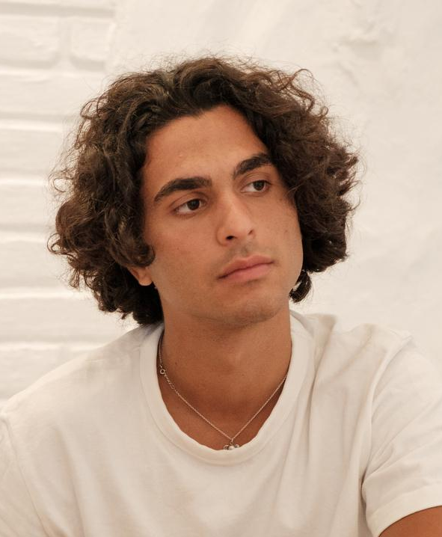
USER PERSONA 1
ABOUT THE USER
ABOUT THE USER
Derek is a confident graphic designer who runs his own freelance business. He works with writers, photographers, and other creative professionals to deliver captivating designs to clients. Derek dreams of growing his solopreneur venture into a design agency.
Down-to-earth
Easy-going
Reliable
Inspiring
Problem solver
PROBLEMS
GOALS AND NEEDS
Presenting his work to a wider audience
Expressing his ideas in words
Keeping his designs and freelancing business relevant
To express his creativity and vision to others
To develop a successful freelance business
To find inspiration from the world around him
DEREK
SAMPLE for reference, please replace with your project details
28 years old
Salguerro
Designer
$45,000 - $139,999
CHALLENGES
Following up with clients on feedback
Billing clients on time
Managing his notes, clippings, and resources

Slide 7
USER PERSONA 2
ABOUT THE USER
ABOUT THE USER
Derek is a confident graphic designer who runs his own freelance business. He works with writers, photographers, and other creative professionals to deliver captivating designs to clients. Derek dreams of growing his solopreneur venture into a design agency.
Down-to-earth
Easy-going
Reliable
Inspiring
Problem solver
PROBLEMS
GOALS AND NEEDS
Presenting his work to a wider audience
Expressing his ideas in words
Keeping his designs and freelancing business relevant
To express his creativity and vision to others
To develop a successful freelance business
To find inspiration from the world around him
DEREK
SAMPLE for reference, please replace with your project details
28 years old
Salguerro
Designer
$45,000 - $139,999
CHALLENGES
Following up with clients on feedback
Billing clients on time
Managing his notes, clippings, and resources

Slide 8
USER PERSONA 3
ABOUT THE USER
ABOUT THE USER
Derek is a confident graphic designer who runs his own freelance business. He works with writers, photographers, and other creative professionals to deliver captivating designs to clients. Derek dreams of growing his solopreneur venture into a design agency.
Down-to-earth
Easy-going
Reliable
Inspiring
Problem solver
PROBLEMS
GOALS AND NEEDS
SAMPLE for reference, please replace with your project details
Presenting his work to a wider audience
Expressing his ideas in words
Keeping his designs and freelancing business relevant
To express his creativity and vision to others
To develop a successful freelance business
To find inspiration from the world around him
DEREK
28 years old
Salguerro
Designer
$45,000 - $139,999
CHALLENGES
Following up with clients on feedback
Billing clients on time
Managing his notes, clippings, and resources

Slide 9


Our Solution
What do you plan to build ?
Who it is for ?
What problem does it addresses ?
How it would work in the real world ?
What impact would create ?
Why it is worth building ?
For which Persona you are providing the solution for

Slide 10
Our Solution Continue

Slide 11



USE of
Artificial Intelligence
SAMPLE for reference, please replace with how your proposed solution leverages AI
AI can automate repetitive tasks, saving time and resources, AI reduces human error in data analysis and decision-making, AI drives innovation by enabling new technologies and applications.

Slide 12
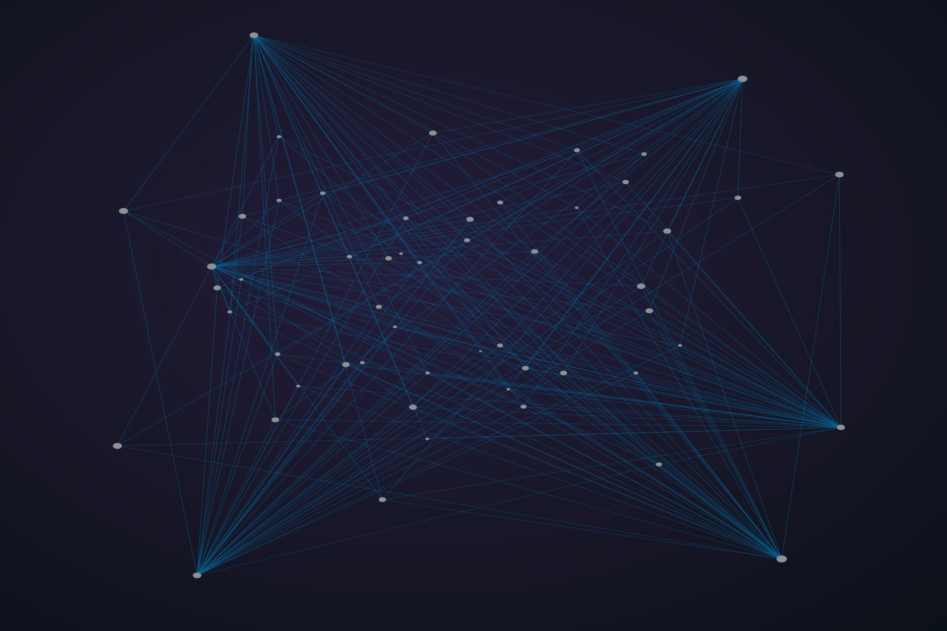
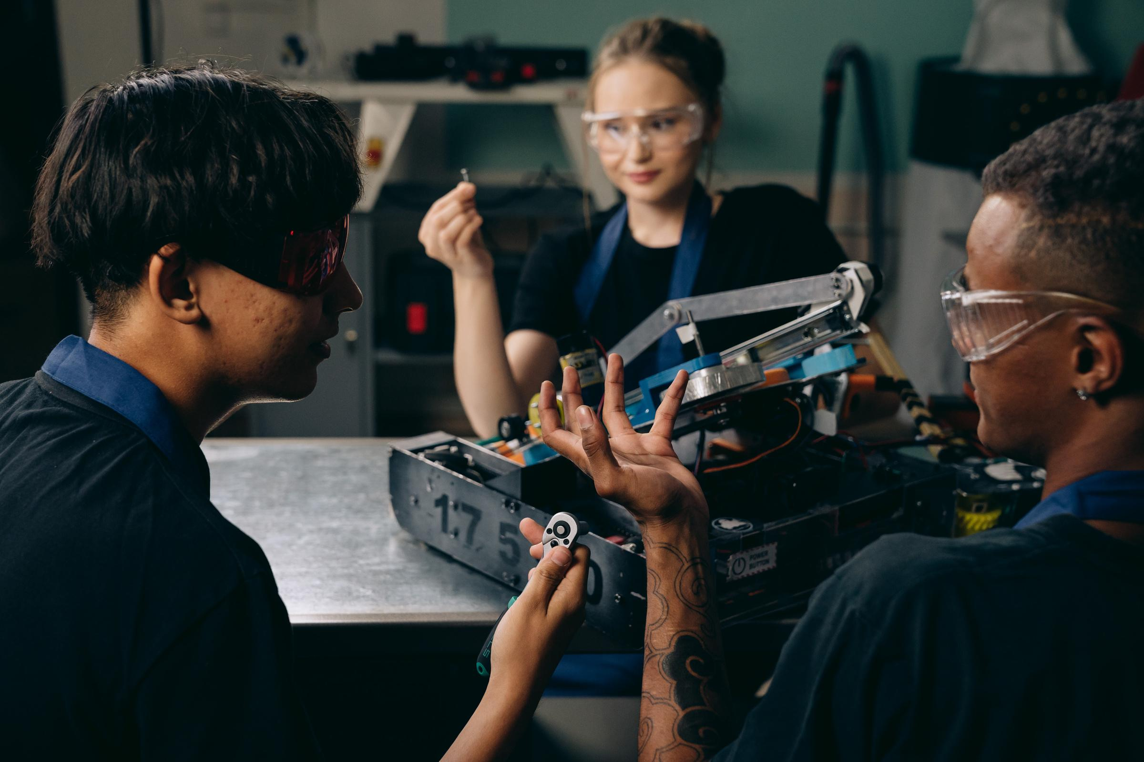
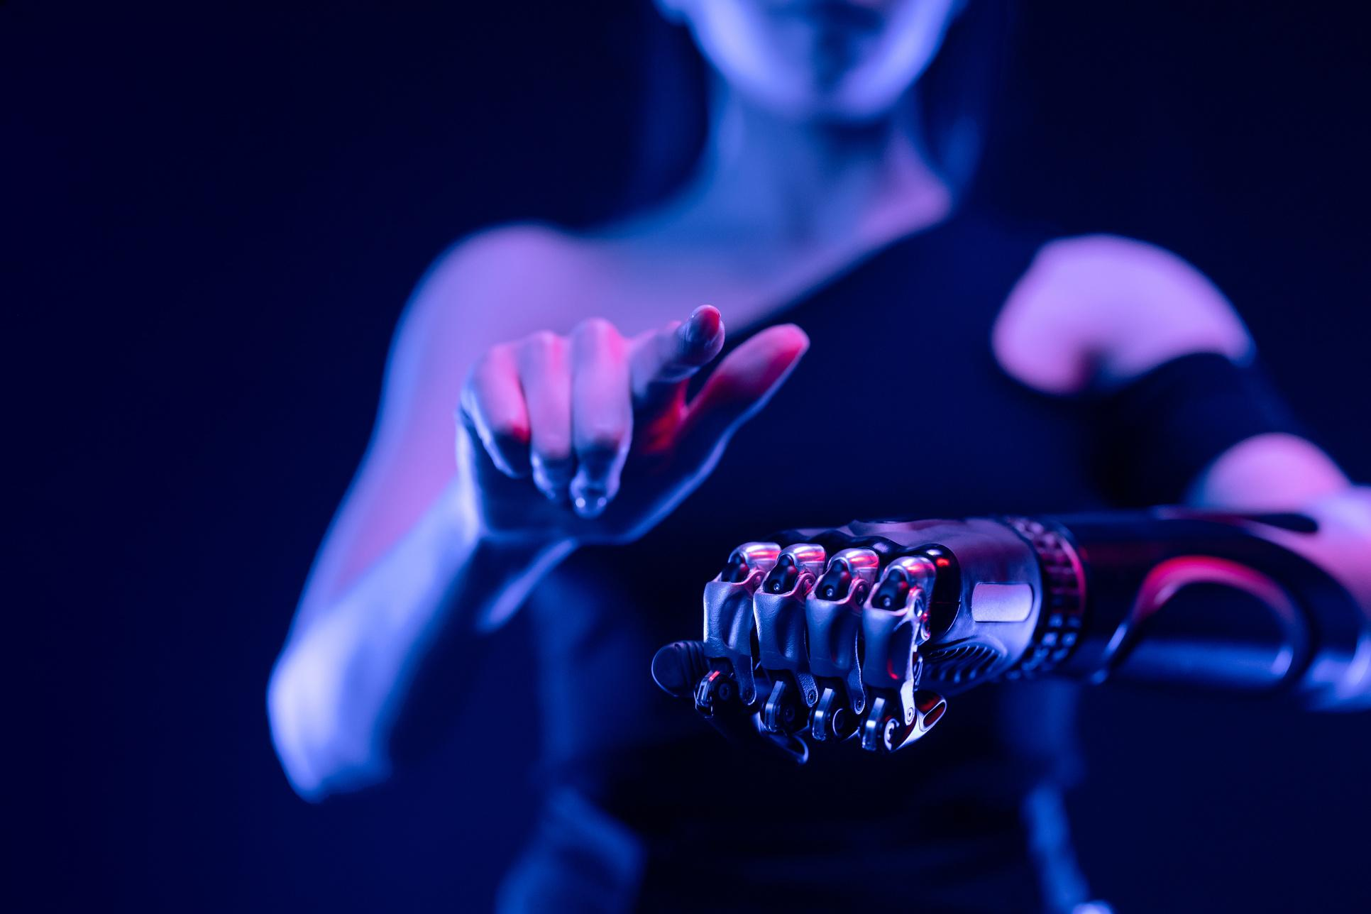
SAMPLE for reference, please replace with your project details
Challenge/risk 1.
Challenges and Risks
Challenge/Risk 2.
Challenge / Risk 3 and so on Add more as required.

Slide 13
Technical Request for Facilitated Datasets
Finalists should categorize their request using the following parameters:
Specification of Required Data
Technical Justification
Data Type: (e.g., Anonymized clinical imagery, Indic-language speech samples, high-res geospatial layers, or structured IoT sensor logs).
Volume & Depth: The minimum required rows, file count, or historical duration (e.g., "5 years of crop yield data across 10 districts").
Granularity: The level of detail needed (e.g., "District-level vs. Village-level" or "Daily vs. Monthly" updates).
Provide a clear rationale for how this facilitated data will improve the prototype:
Accuracy/Validation: "We need the AI4India health records to validate our model trained on synthetic data."
Feature Engineering: "Real-time traffic feed is required to move from static route optimization to dynamic smart-city scaling."
Edge-Case Handling: "Specific regional dialect data is needed to ensure the educational bot works for the underserved unserved populations."
The "Ask" vs. "Leveraged" Mapping
Environment & Security Requirements
What you have: List the open-source data (Bhashini, OGD, etc.) you have already successfully integrated.
What you need: Identify the specific "Facilitated Dataset" from AI4India that acts as the missing piece for model accuracy or localized impact.
Access Method: Request preference for data delivery (e.g., Secure API, direct download, or sandbox environment access on AIKosh).
Security Compliance: Confirm that your team has an environment ready to handle sensitive/facilitated data according to DPDP (Data Protection) standards.

Slide 14
Anticipated Results
Absolutely the last set of information to add!
Really Great Company
Which Persona benefits the most and estimated advantage (quantified)
Work increases for which persona and estimated increase
Solution scalability - operationally and technically

Slide 15
THANK YOU
for your time and attention

